Slide 1

Hospitality Management
Navy-09
By: Pardis, Jesu, Khalid, & Nusayba

Slide 2
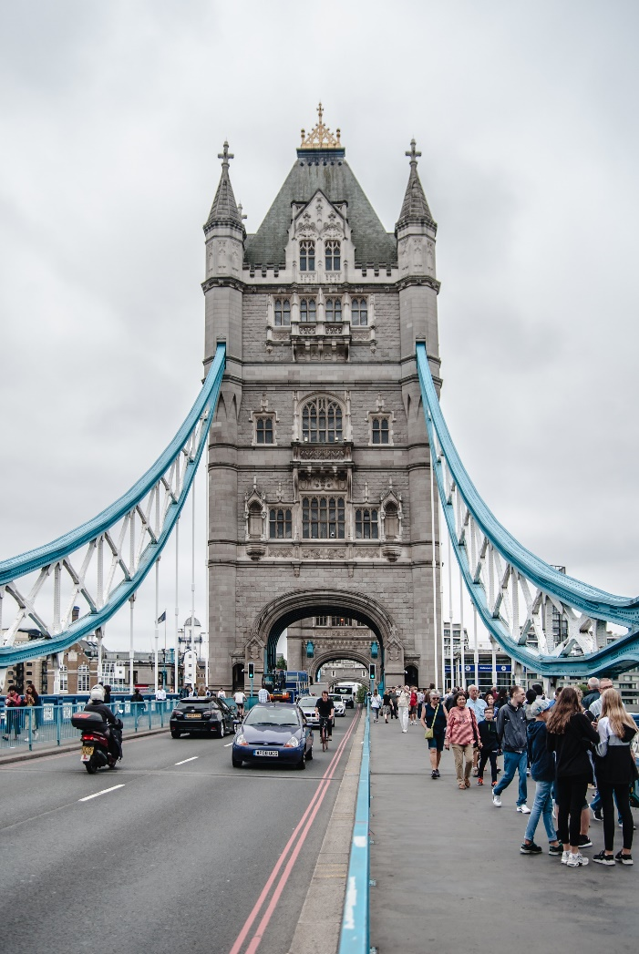
Overview
Group accommodation during travel in European cities.

Slide 3
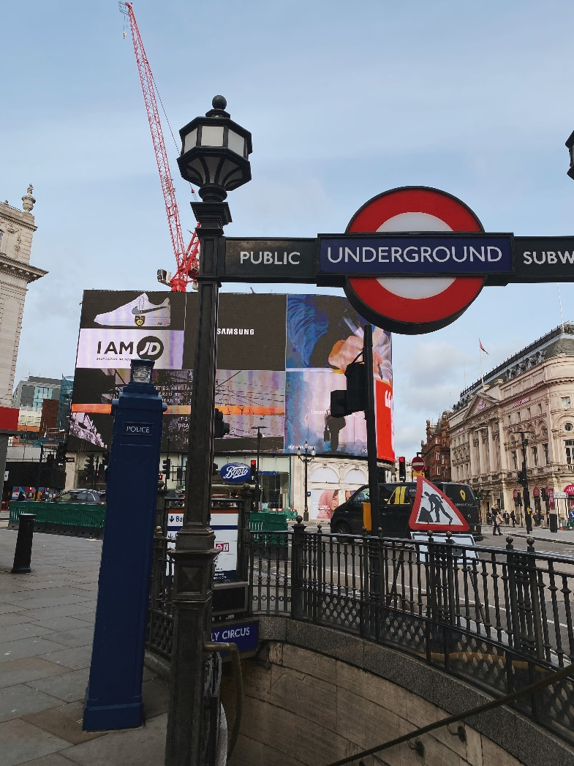
Purpose
Our project strives to provide travelers first with an application that can help facilitate local travel and secondly and with a platform to meet people to share experiences with.
Notes:
Our project strives to provide travelers first with an application that can help facilitate local travel and secondly and with a platform to meet people who to share experiences with.

Slide 4


Storyboard: Login
The first part of the project is the user interface.
Users add their relevant personal information that will help match with others
Next, for safety and communication, the user will connect their social media (Instagram, Facebook,…).
Finally, the user gets into the main part of the application, then it will add its travel information.
This application considers four important things:
1. Transportation systems
2. Places
3. Restaurants
4. Events and shows
Notes:
(We just focused on Subway transportation)
Local attractions (sorted by relevance?), should we include places to stay?

Slide 5
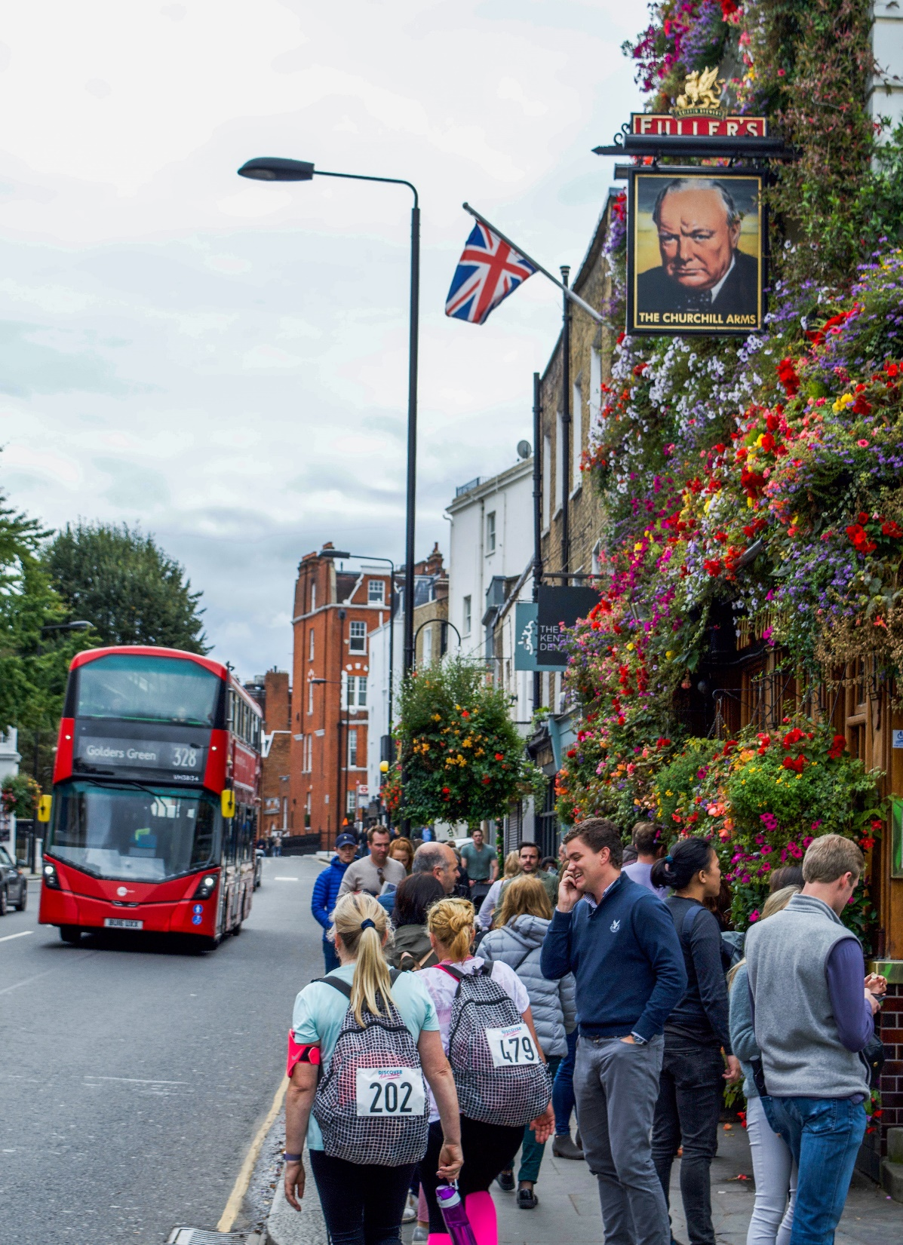
Storyboard: Transportation
One of our main focuses is transportation.
The user enters their location and the intended destination.
Users can choose transportation method: Walking or train.
Next, the app will show users (Users Visibility) bus or train stations nearby that lead to their destination.
Notes:
Then it will match the user with other users (like chat options and social media connection).

Slide 6

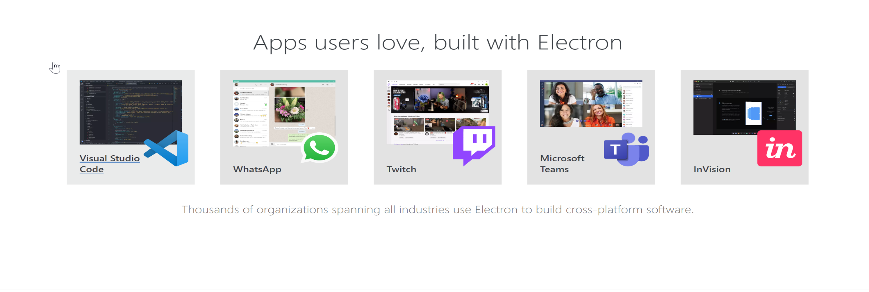
Technical Platform
Designing an application with electron JS.
If you can build a website, you can build a desktop app.
Electron is a framework for creating native applications with web technologies like JavaScript, HTML, and CSS. It takes care of the hard parts so you can focus on the core of your application. We will use python for our back-end (Python Flask).

Slide 7
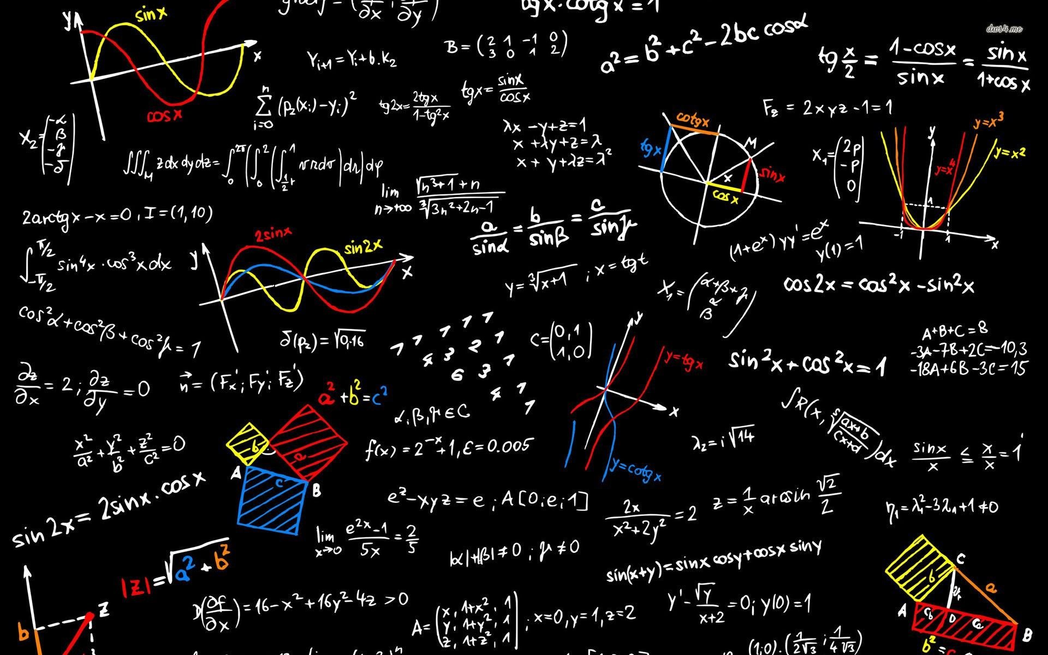
Technical Platform
We will use python for our back-end (Python Flask). We chose the K-nearest algorithm (KNN), which finds k nearest neighbors (meaning, similar historic trips over a period of time) and then performs a regression on them to create a prediction.
Notes:
GPS tracking or path generation?
Training data or lack of attritributes

Slide 8
Thank you for listening!

